Slide 1
Comparison of vowel detection methods.
Yash Bhatia 2020101007
Laksh Balani 2020102019
Ishanya Sethi 2020102014

Slide 2
Introduction
Vowels are long duration, periodic and high energy sound units in a speech utterance
Vowel Onset Point (VOP) are the instants of starting of a vowel.
Vowel End Point (VEP) are the instants of ending of a vowel.
Both of these are equally important for accurate detection of vowels.
The frequency response of the vocal-tract system as well as the excitation source information are better manifested within the vowels
A vowel sound unit may be viewed as consisting of three regions viz. onset, steady and offset regions.
The change in signal energy and periodicity at the VOPs is quite sharp and comparatively higher.
Signal magnitude maintains a nearly constant value within the steady regions.
The signal decays slowly around VEPs

Slide 3
Motivation
It can be useful in modifying the speech duration. This is because, vowels have more change in duration than other regions.
The speaking rate is directly proportional to the number of vowels spoken per second. So, it can help in speaking rate estimation.
Syllable is a part of word which contains a single vowel sound and is pronounced as a single unit. Hence, vowel detection is useful in syllable detection as well.
The knowledge of the VOPs serve as reference for extracting prosodic features from the speech signal

Slide 4
Work Done So Far
Reading and understanding all the research papers provided to us, covering various methods for vowel detection.
Implemented the code for removing unvoiced regions and noise signals from the speech signal i.e. speech enhancement.
Future Work:
Implementing the detection of vowel onset and offset points using non-local similarity between DWT approximation coefficients
Implementing the detection of vowel onset and offset points using average magnitude dynamics(AMD)
Implementing the detection of vowel onset points using the spectral energy at formant frequencies present in the glottal closure region.

Slide 5
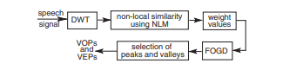
Detection of vowel onset and offset points
using non-local similarity between
DWT approximation coefficients
First, energy due to long duration high-frequency sound units is suppressed by using discrete wavelet transform (DWT).
Then, similarity between the analysis frames are computed and averaged over a neighbourhood by using non-local means (NLM) estimation.
Significant transition points in the weight values are then detected by convolving it with a first-order difference of Gaussian windows. The amount of smoothing to be applied is controlled by the bandwidth parameter.

Slide 6
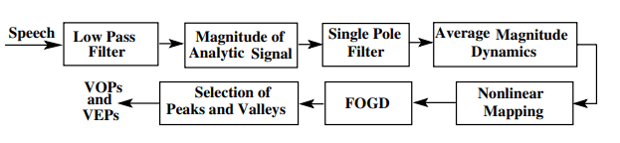
Detection of vowel onset and offset points using average magnitude dynamics(AMD)
The speech signal is first processed through a low-pass filter to preserve the signal components corresponding to 0–2500 Hz frequency band. Then, the analytic signal xa(n) of the low-pass filtered is constructed by using the Hilbert transform
At each time instant, the differences between L preceding and succeeding sample values are computed. The mean of L difference values (nonlocal slopes) will represent the AMD at that time instant.
Significant transition points in NL-AMD are then convolved by convolving it with a Gaussian window having a standard deviation one sixth of the window length.

Slide 7
Contribution
Three techniques, namely non-local similarity between DWT approximation coefficients, average magnitude dynamics (AMD), and spectral energy at formant frequencies, will be used to detect vowels. We've chosen to distribute one approach each team member. Later, based on the graphs and corresponding analysis of each method, we will compare them.

Slide 8
Thank You

